Slide 1

21BIO112
INTELLIGENCE IN BIOLOGICAL SYSTEMS
Converting DNA to Proteins
Team Members
BL.EN.U4AIE21015 : SAI ABHISHEK
BL.EN.U4AIE21017 : RUCHITH BALAJI
BL.EN.U4AIE21038 : CHILLAKURU HARI
Dept. of AIE ASE,BANGLORE
1

Slide 2
Contents
Introduction
RNA
DNA
DNA to RNA
Code
Output
Dept. of AIE ASE,BANGLORE

Slide 3
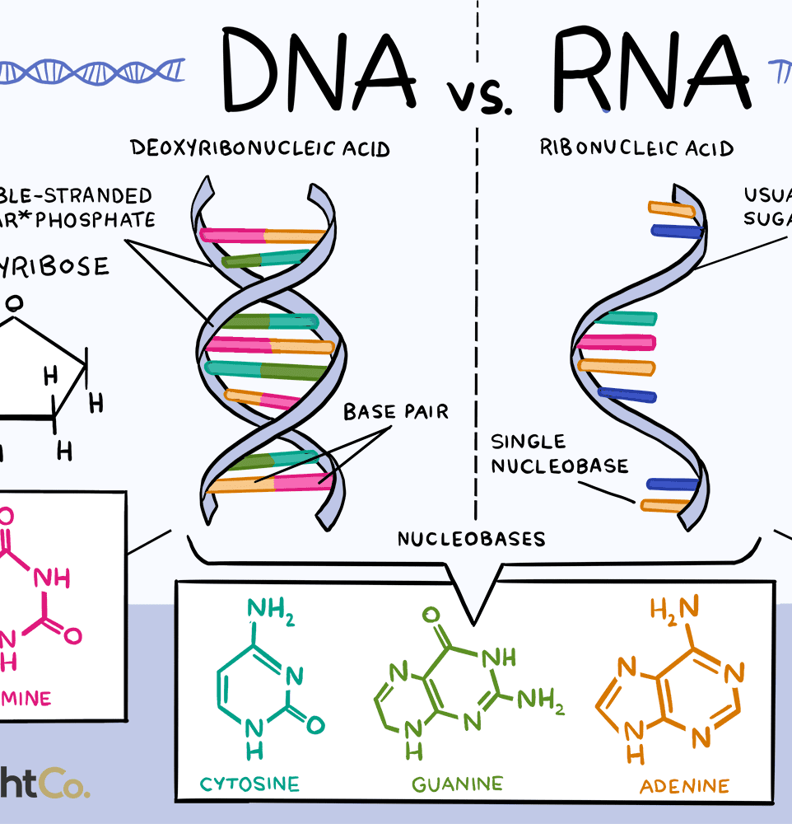
Introduction:
Life on earth is very diverse, from single-celled protozoans to complex multicellular plants and animals. But at the molecular level, all life is fundamentally made up of the same building blocks – DNA and RNA.
One of the primary differences between DNA and RNA is that DNA is double-stranded while RNA is single-stranded.
Dept. of AIE ASE,BANGLORE

Slide 4
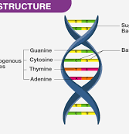
DNA
Deoxyribonucleic acid is a polymer composed of two polynucleotide chains that coil around each other to form a double helix.
It is responsible to carry genetic instructions for the development ,functioning , growth and reproduction of all known organisms.
Each nucleotide consists of three components :
a) Phosphate group
b) Sugar molecule
c) Nitrogenous base
Dept. of AIE ASE,BANGLORE

Slide 5
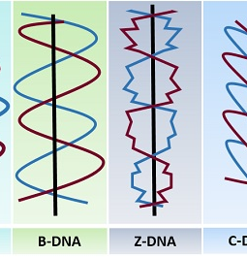
DNA
The DNA molecules contain instructions a living entity requires to grow, develop and reproduce. These instructions are present inside each cell and are inherited from the parents to their offspring.
It is made up of nucleotides which contain a nitrogenous group, a phosphate group, and a sugar group. The order of the nitrogenous bases – thymine(T), guanine(G), cytosine(C), and adenine(A), is crucial in determining the genetic code.
Types of DNA:
a) A – DNA
b) B – DNA
c) C – DNA
d) D – DNA
e) Z – DNA
Dept. of AIE ASE,BANGLORE

Slide 6
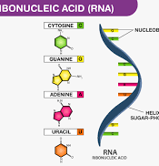
RNA
1) Ribonucleic acid is a nucleic acid present in all living cells that acts as a messenger carrying instructions from DNA for controlling the synthesis of proteins .
2) Ribonucleic acid is a single stranded .
3) RNA has a backbone made of alternating phosphate groups and the sugar ribose .
Dept. of AIE ASE,BANGLORE

Slide 7
RNA
RNA contains the sugar ribose, phosphates, and the nitrogenous bases adenine (A), guanine (G),cytosine (C), and uracil (U). DNA and RNA share the nitrogenous bases A, G, and C. Thymine is usually only present in DNA and uracil is usually only present in RNA.
Types Of RNA
Only some of the genes in cells are expressed into RNA. The following are the types of RNA wherein each type is encoded by its own type of gene:
tRNA– The transfer RNA or the tRNA carries amino acids to ribosomes while translation
mRNA – The messenger RNA or the mRNA encodes amino acid sequences of a polypeptide
rRNA – The ribosomal RNA or the rRNA produces ribosomes with the ribosomal proteins that are organelles responsible for the translation of the mRNA.
snRNA – The small nuclear RNA forms the complexes along with proteins which are utilized in RNA processing in the eukaryotes.
Dept. of AIE ASE,BANGLORE

Slide 8
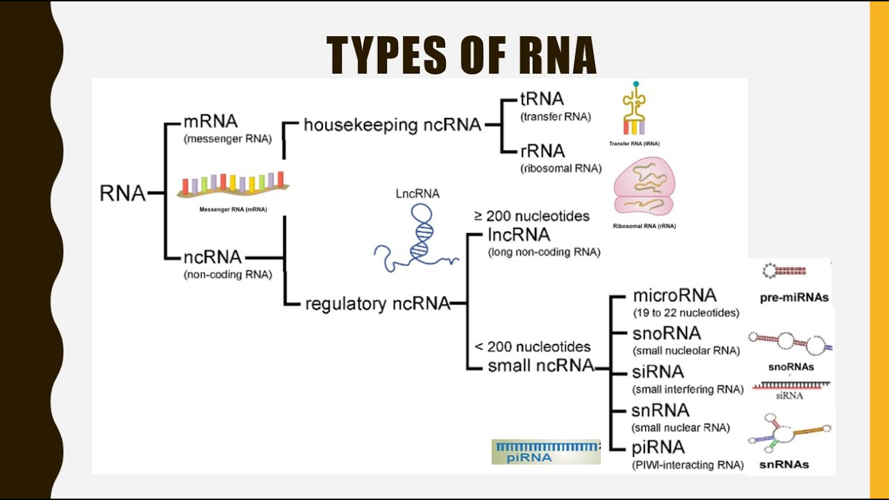
RNA
Dept. of AIE ASE,BANGLORE

Slide 9
Role of Proteins
To place these ideas in the proper context, remember that some proteins are enzymes that aid cells by catalyzing chemical reactions.
These chemical reactions occur after the enzyme binds its substrate at the enzyme’s active site.
The enzyme’s active site matches the substrate molecule in size, shape and chemical properties.
Proteins play a critical role in how cells successfully meet the challenges of living. Cells use
proteins to maintain their shape and to speed up important chemical reactions such as photosynthesis and respiration.
A cell will not live long if it cannot reliably create the proteins that it needs for survival.
Dept. of AIE ASE,BANGLORE

Slide 10
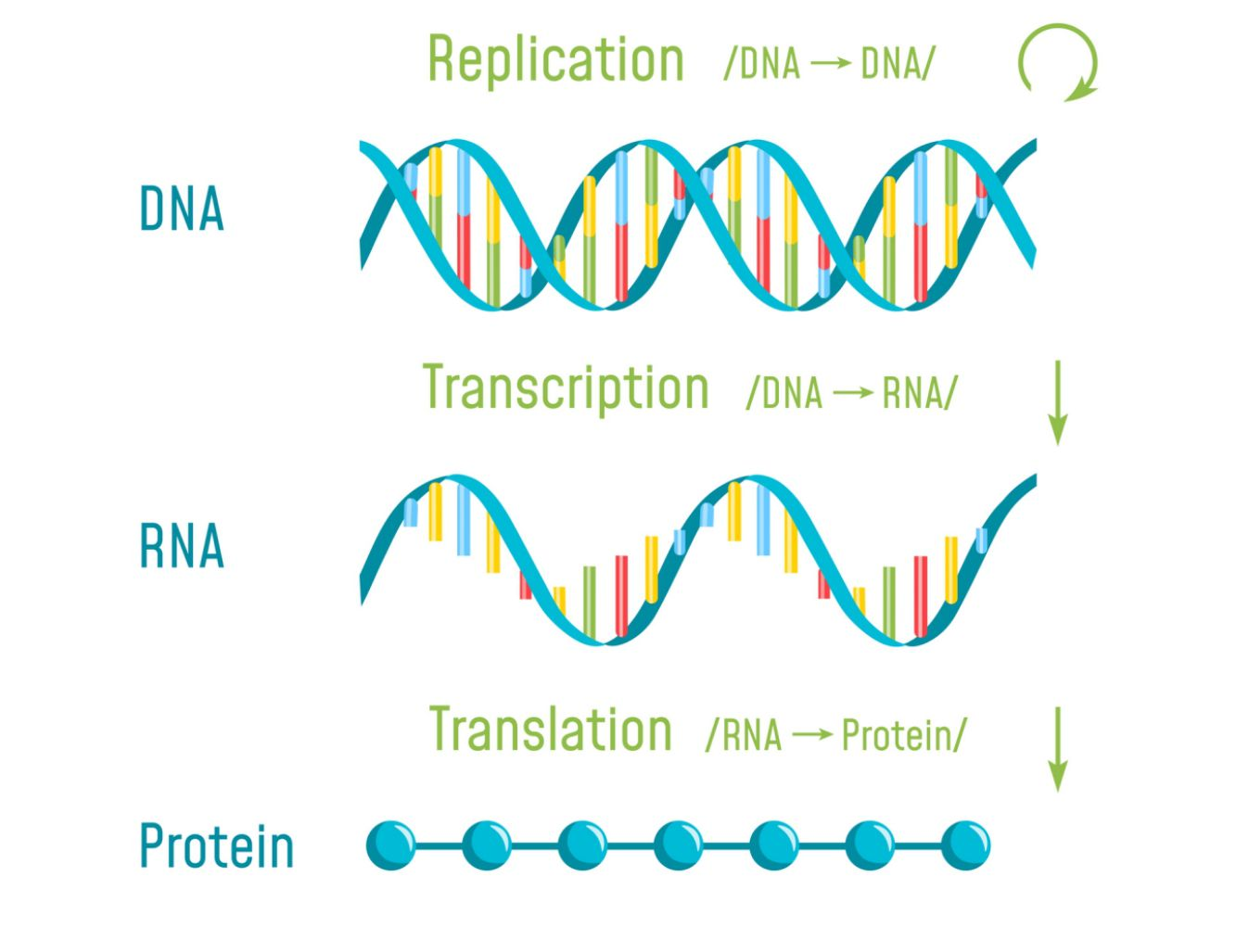
DNA to PROTEINS
The journey from gene to protein is complex and tightly controlled within each cell. It consists of two major steps: transcription and translation.
Together, transcription and translation are known as gene expression.
Dept. of AIE ASE,BANGLORE

Slide 11
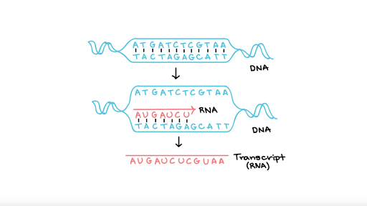
DNA to RNA (Transcription)
Process by which DNA is copied to RNA is called transcription .
It involves the copying the gene’s DNA sequence to make an RNA molecule .
During the process of transcription, the information stored in a gene's DNA is passed to a similar molecule called RNA (ribonucleic acid) in the cell nucleus.
Both RNA and DNA are made up of a chain of building blocks called nucleotides,
Dept. of AIE ASE,BANGLORE

Slide 12
Transcription
Consider the following DNA string as an example.
AATTTGCTTGGCAAATCGTATGCCTTGGG
You can obtain the relevant RNA string as follows, by replacing all occurrences of T with U.
AAUUUGCUUGGCAAAUCGUAUGCCUUGGG
Dept. of AIE ASE,BANGLORE

Slide 13
RNA to PROTEINS(Translation)
Translation is the second part of the central dogma of molecular biology: RNA → Protein. It is the process in which the genetic code in mRNA is read, one codon at a time, to make a protein.
Translation of the codons in mRNA to a chain of amino acids occurs at a ribosome. Notice the growing amino acid chain attached to the tRNAs and ribosome.
Summary
Translation is the RNA → Protein part of the central dogma.
Translation occurs at a ribosome.
During translation, a protein is synthesized using the codons in mRNA as a guide.
All three types of RNA play a role in translation.
Dept. of AIE ASE,BANGLORE

Slide 14
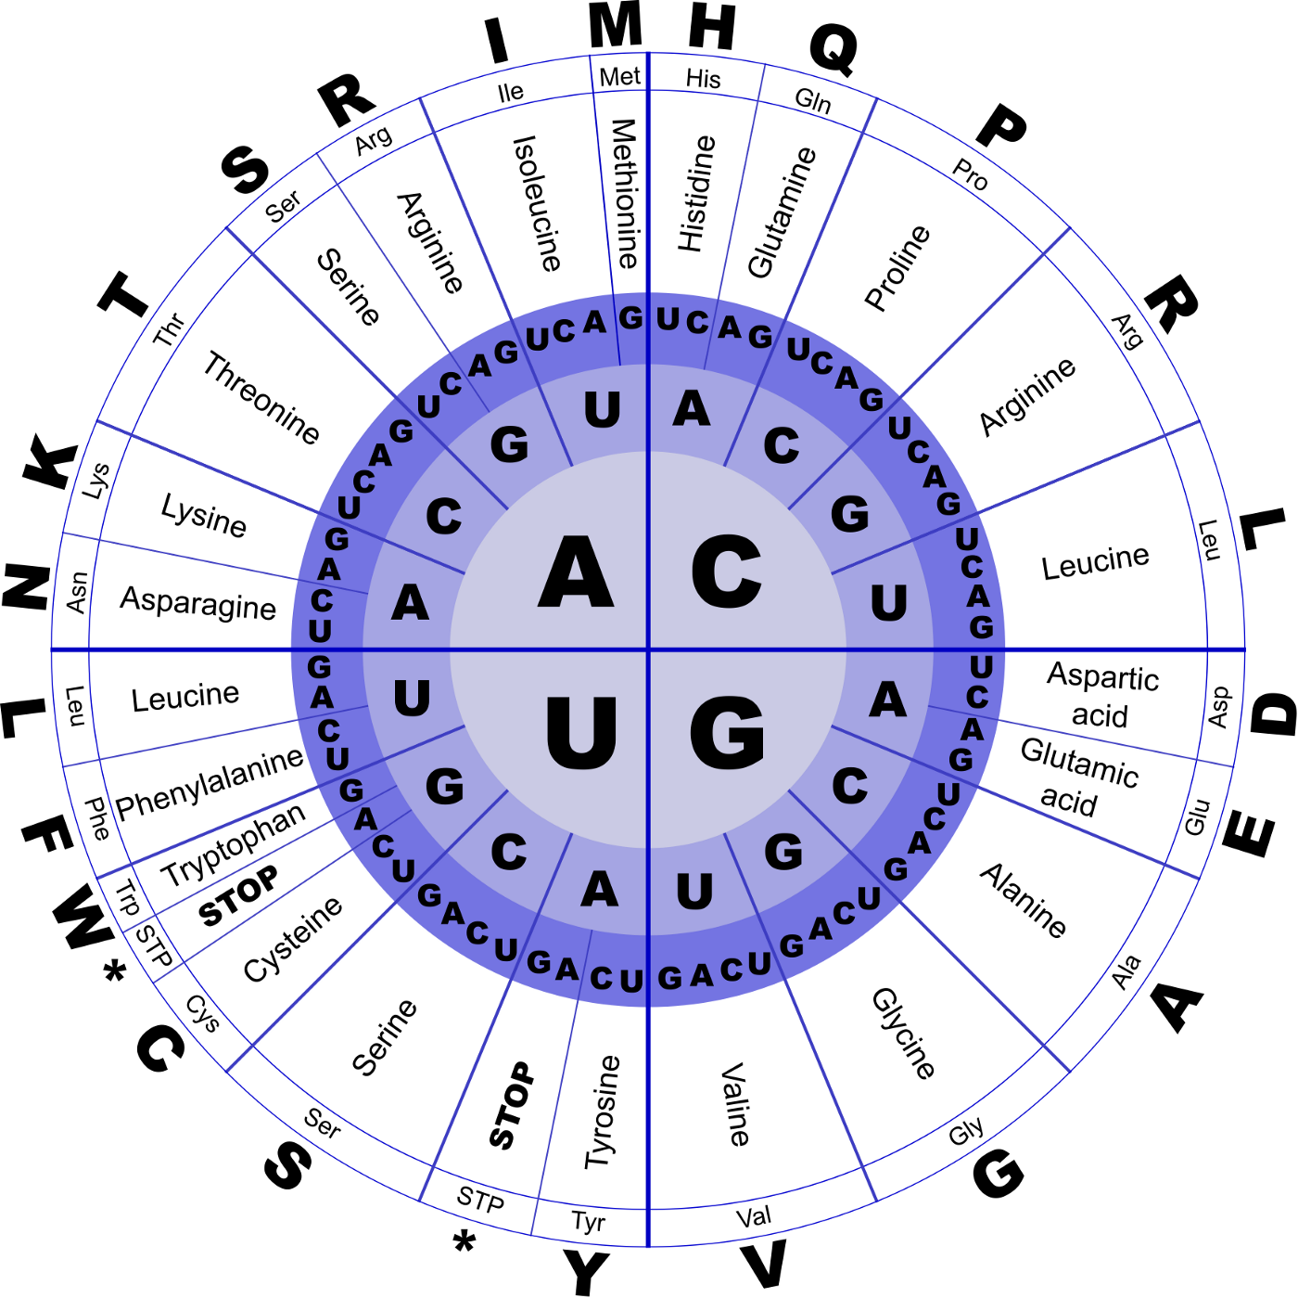
Translation
If you know an RNA sequence, you can translate it into the corresponding protein sequence by using the genetic code. This is the same way the cell itself generates a protein sequence.
The genetic code for RNA (also called RNA codon table) shows how we uniquely relate a 4-nucleotide sequence (A, U, G, C) to a set of 20 amino acids.
The diagram given below shows the genetic code for RNA in the form of a chart.
Dept. of AIE ASE,BANGLORE

Slide 15
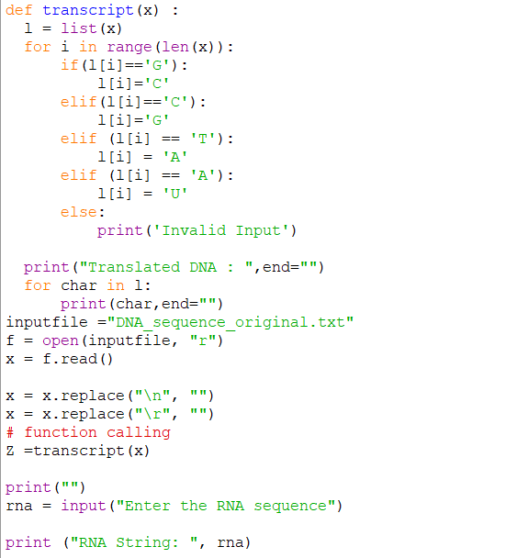
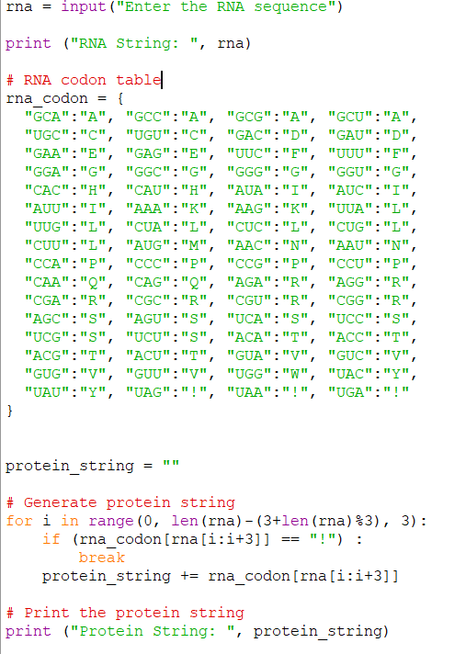
Code
DNA to RNA
RNA to Proteins

Slide 16
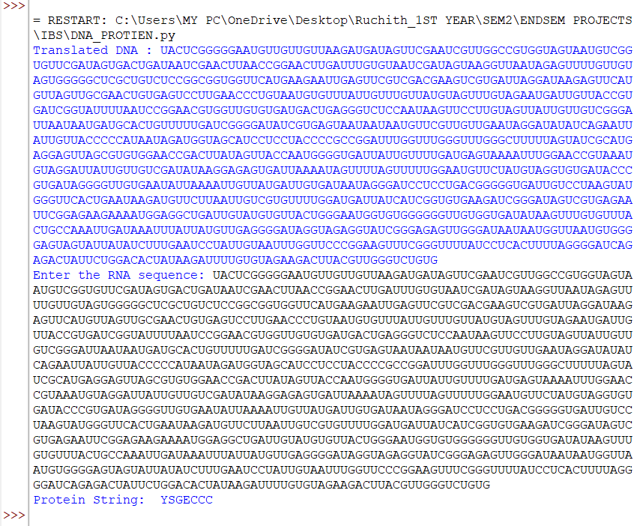
Output
Dept. of AIE ASE,BANGLORE

Slide 17
Conclusion
The final product of the transcription is mRNA which is directly used in the translation once it migrates to the cytoplasm.
Whereas the final product of the translation is a chain of amino acid, although it does not directly form a protein.
Transcription is a highly complex series of events that involves the interaction of numerous proteins and nucleic acids to result in an mRNA strand that can be translated into a protein.
Dept. of AIE ASE,BANGLORE

Slide 18
THANK YOU
Dept. of AIE ASE,BANGLORE

